Slide 1

Analyzing Auto Theft in Toronto
By David Toca, Soroush, Arjun & Zoya

Slide 2

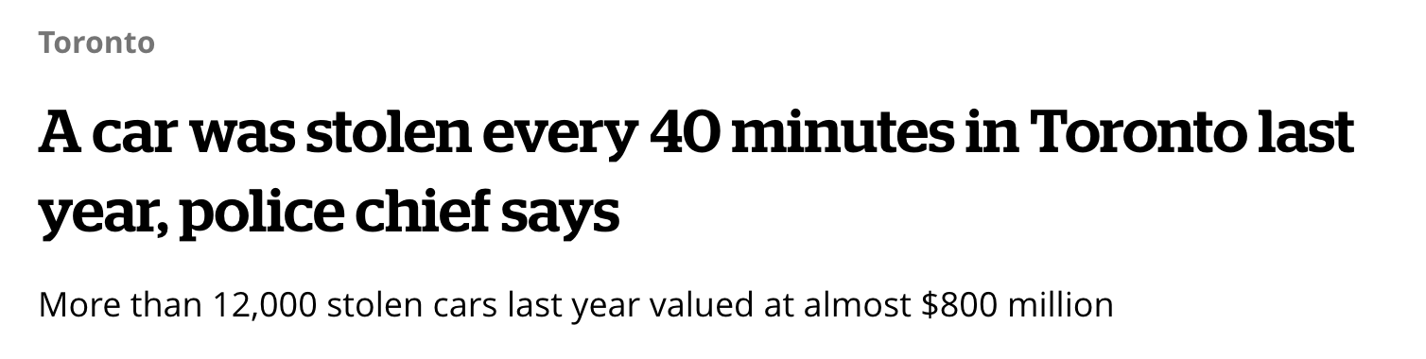
Notes:
Brief overview of auto theft issues in Toronto.
Importance of using ML (Machine Learning) for predicting and preventing auto theft.

Slide 3
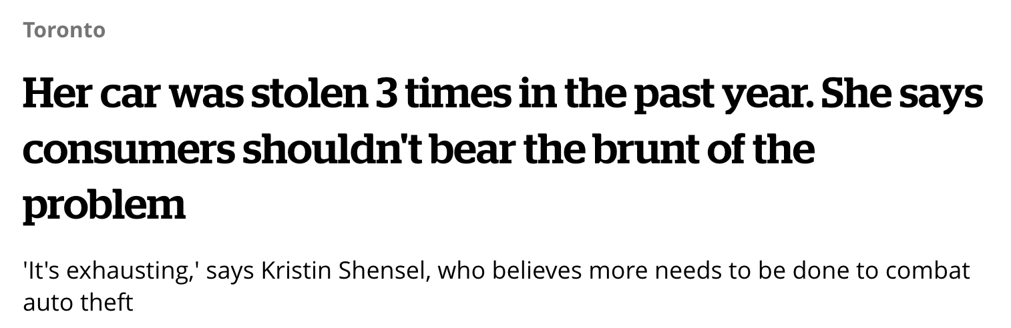
Notes:
Brief overview of auto theft issues in Toronto.
Importance of using ML (Machine Learning) for predicting and preventing auto theft.

Slide 4
Objectives
1
2
3
Identify trends and patterns in auto theft.
Predict future incidents using ML
Recommend strategies for reduction.

Slide 5
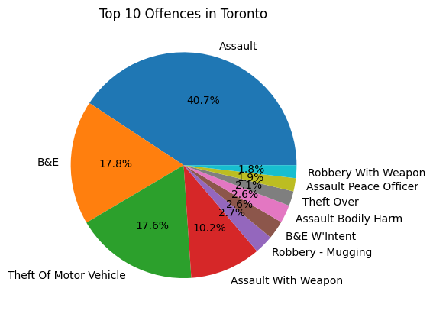
Exploratory Data Analysis
Assault 135392
B&E 59033
Theft Of Motor Vehicle 58441
Assault With Weapon 33764
Robbery - Mugging 9053

Slide 6
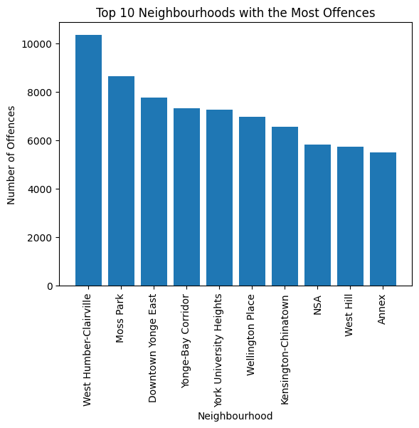
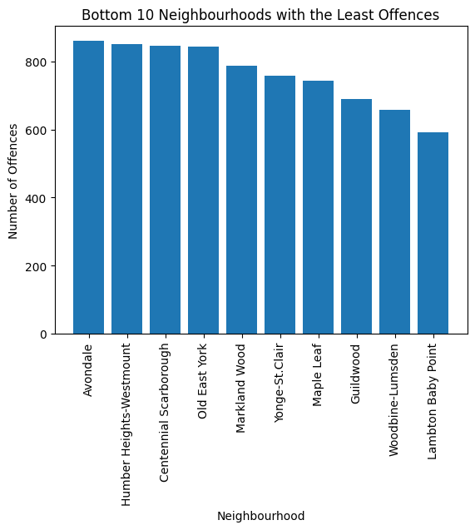
Geospatial Analysis

Slide 7
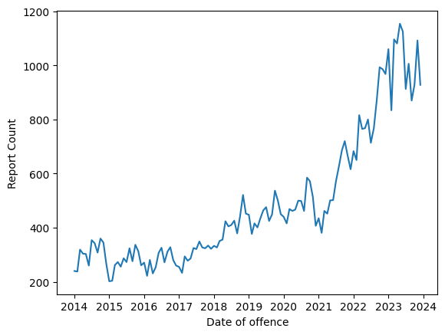
Trends Over Time
Graphs showing auto theft rates over months/years.
Discussion on any observed seasonal variations or significant spikes

Slide 8
Model Development
1
2
3
EDA
Feature engineering and selection
Model training and validation approach

Slide 9
Model Development
1
2
3
EDA
Feature engineering and selection
Model training and validation approach

Slide 10
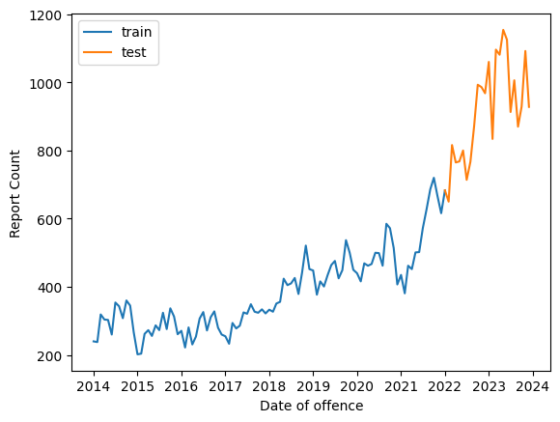
Train/Test
Split
Time series
- Cross sectional

Slide 11
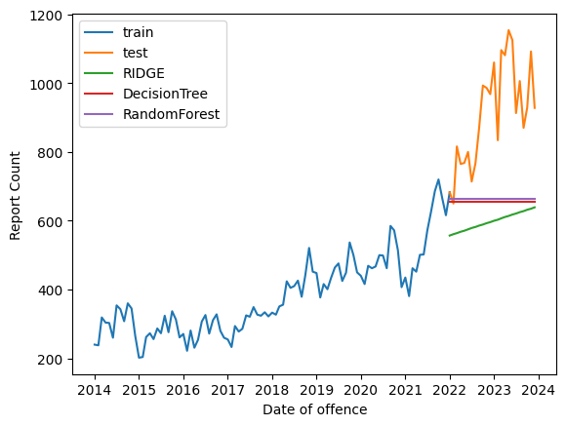
Baseline model
[RandomForest] RMSE: 81968.5
[DecisionTree] RMSE: 87013.5
[RIDGE] RMSE: 114543.25

Slide 12
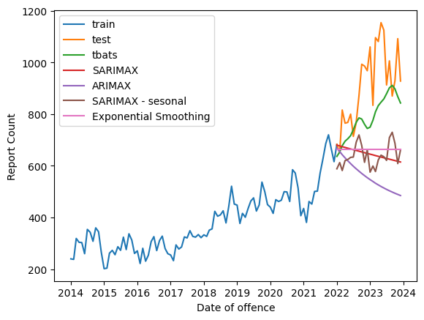
Model Evaluation
[tbats]RMSE: 28015.921493989135
[Exponential Smoothing]RMSE: 82395.48280094985
[PROFET]RMSE: 83056.0
[SARIMAX]RMSE: 95095.38284928202
[SARIMAX sesonal]RMSE: 97012.20435403874
[ARIMAX]RMSE: 159184.83004862323

Slide 13
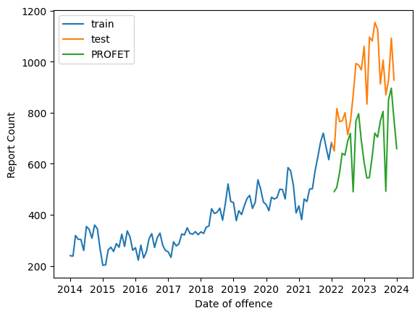
Promising Model

Slide 14
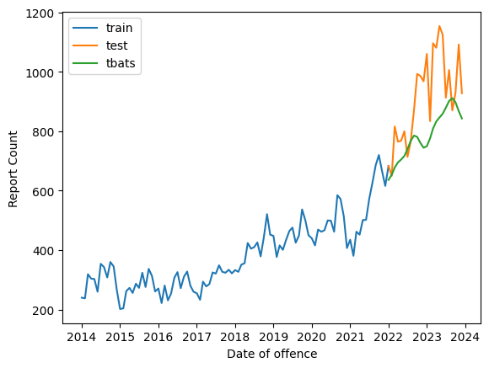
Best Model
Tbats is a forecasting method to model time series data. The main aim of this is to forecast time series with complex seasonal patterns using exponential smoothing

Slide 15
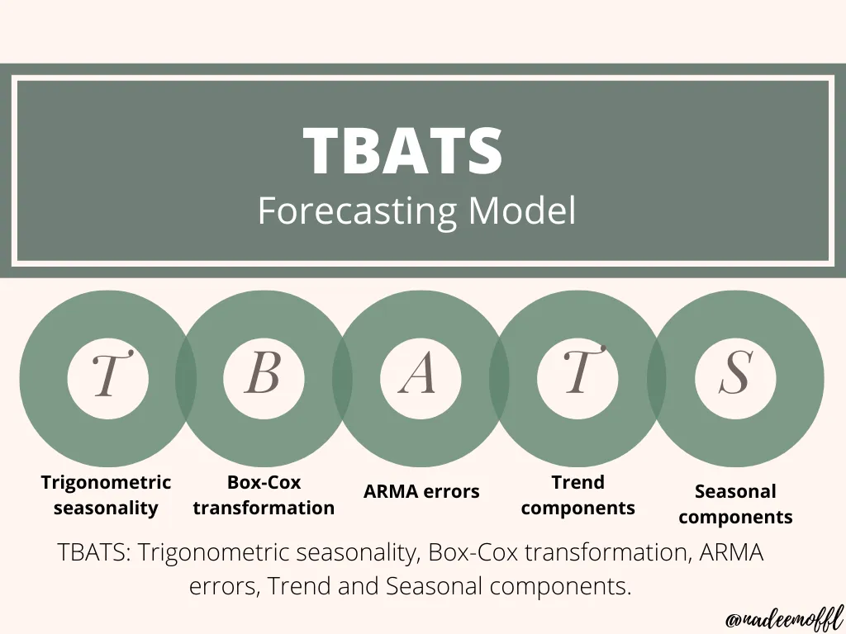

Slide 16
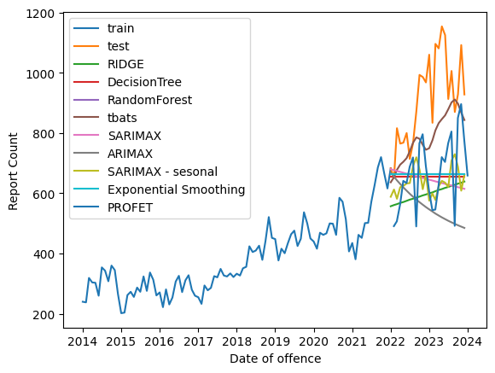
ALL Models

Slide 17

Conclusion
Auto Theft crime is on the rise
Time Series data analysis requires a specific toolset and different treatment
Crime prediction is inherently complex due to the dynamic nature of criminal activities and the multitude of factors influencing crime patterns

Slide 18
Thank You!

Slide 19
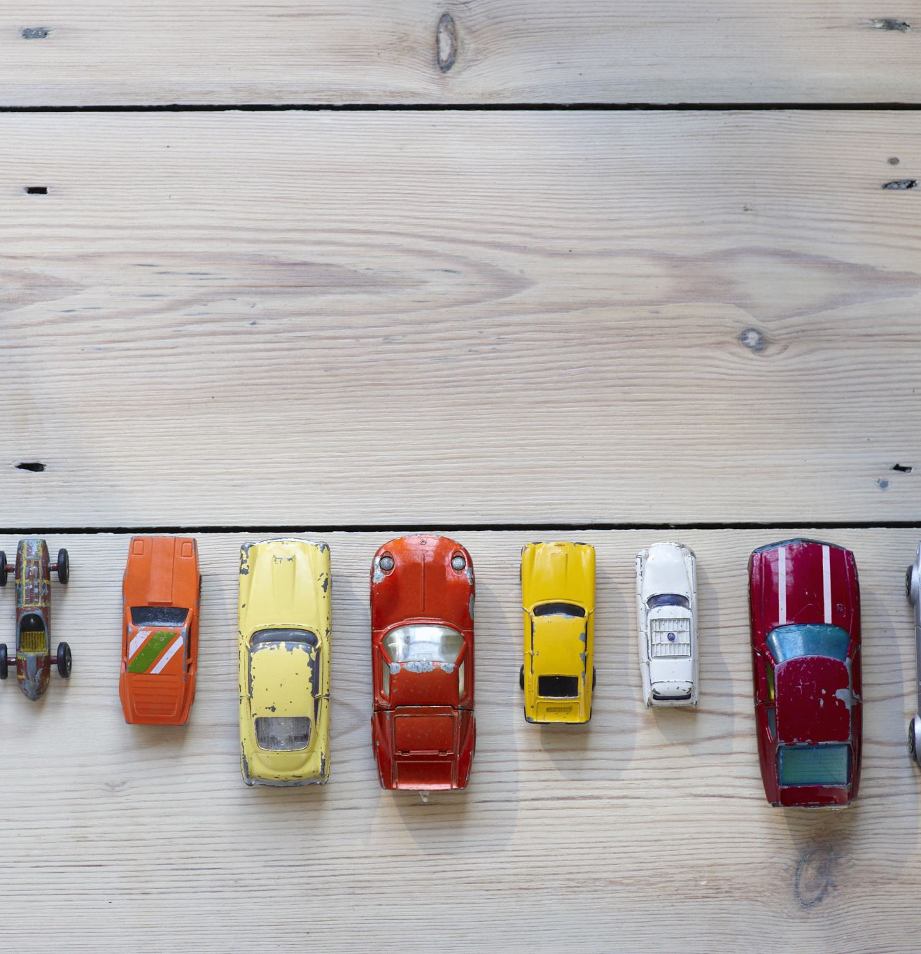

Machine Learning Predictive Models

